Slide 1

PowerShell in Notebooks

Slide 2

Rob Sewell
Bearded Consultant, Automator,
Trainer
Consultant Sewells Consulting Ltd
dbatoolsMoL dbachecks PowerShell & Data Community
beard.media\book
@sqldbawithbeard
SQLDBAWithABeard.com

Slide 3
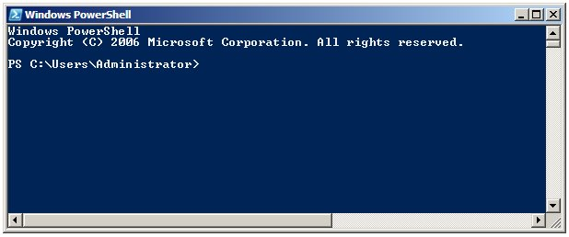
Running PowerShell
2006

Slide 4
Running PowerShell
2006

Slide 5
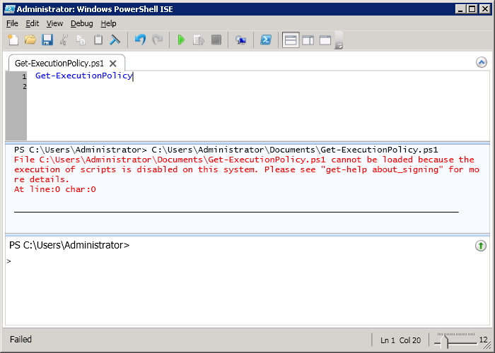
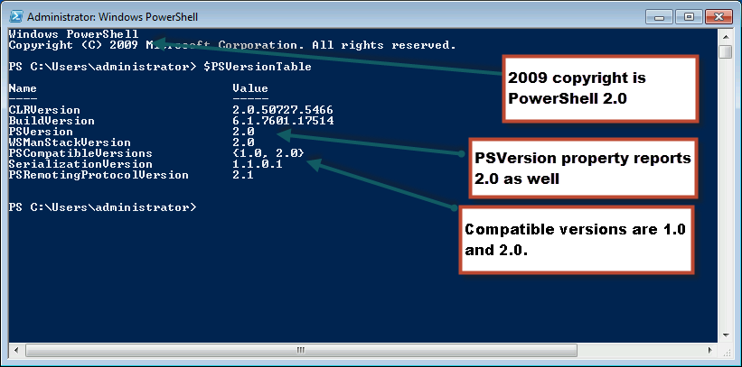
Running PowerShell
2010

Slide 6
Running PowerShell
2010

Slide 7
Running PowerShell
2010

Slide 8
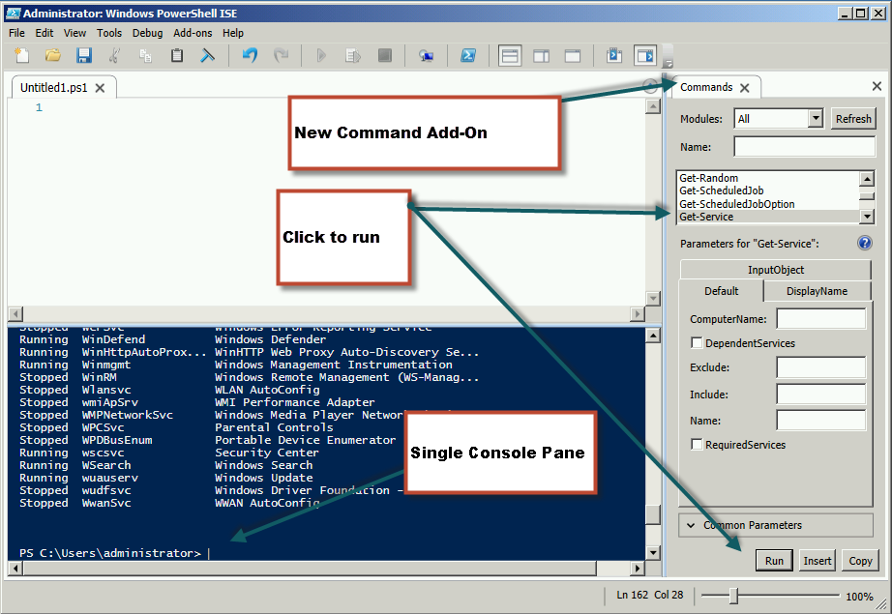
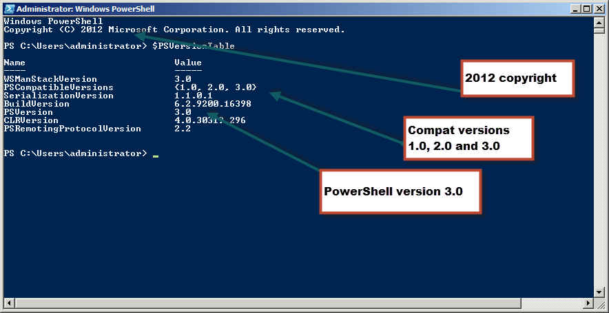
Running PowerShell
2012

Slide 9
Running PowerShell
2012

Slide 10
Running PowerShell
2012

Slide 11
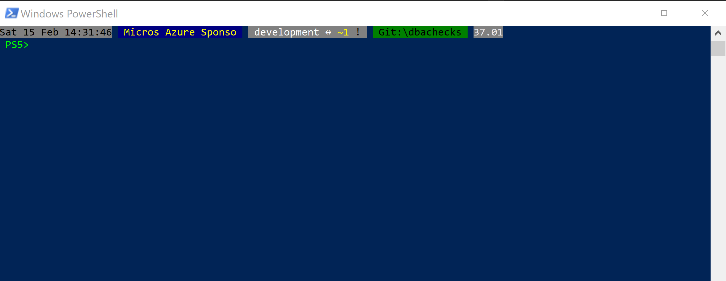
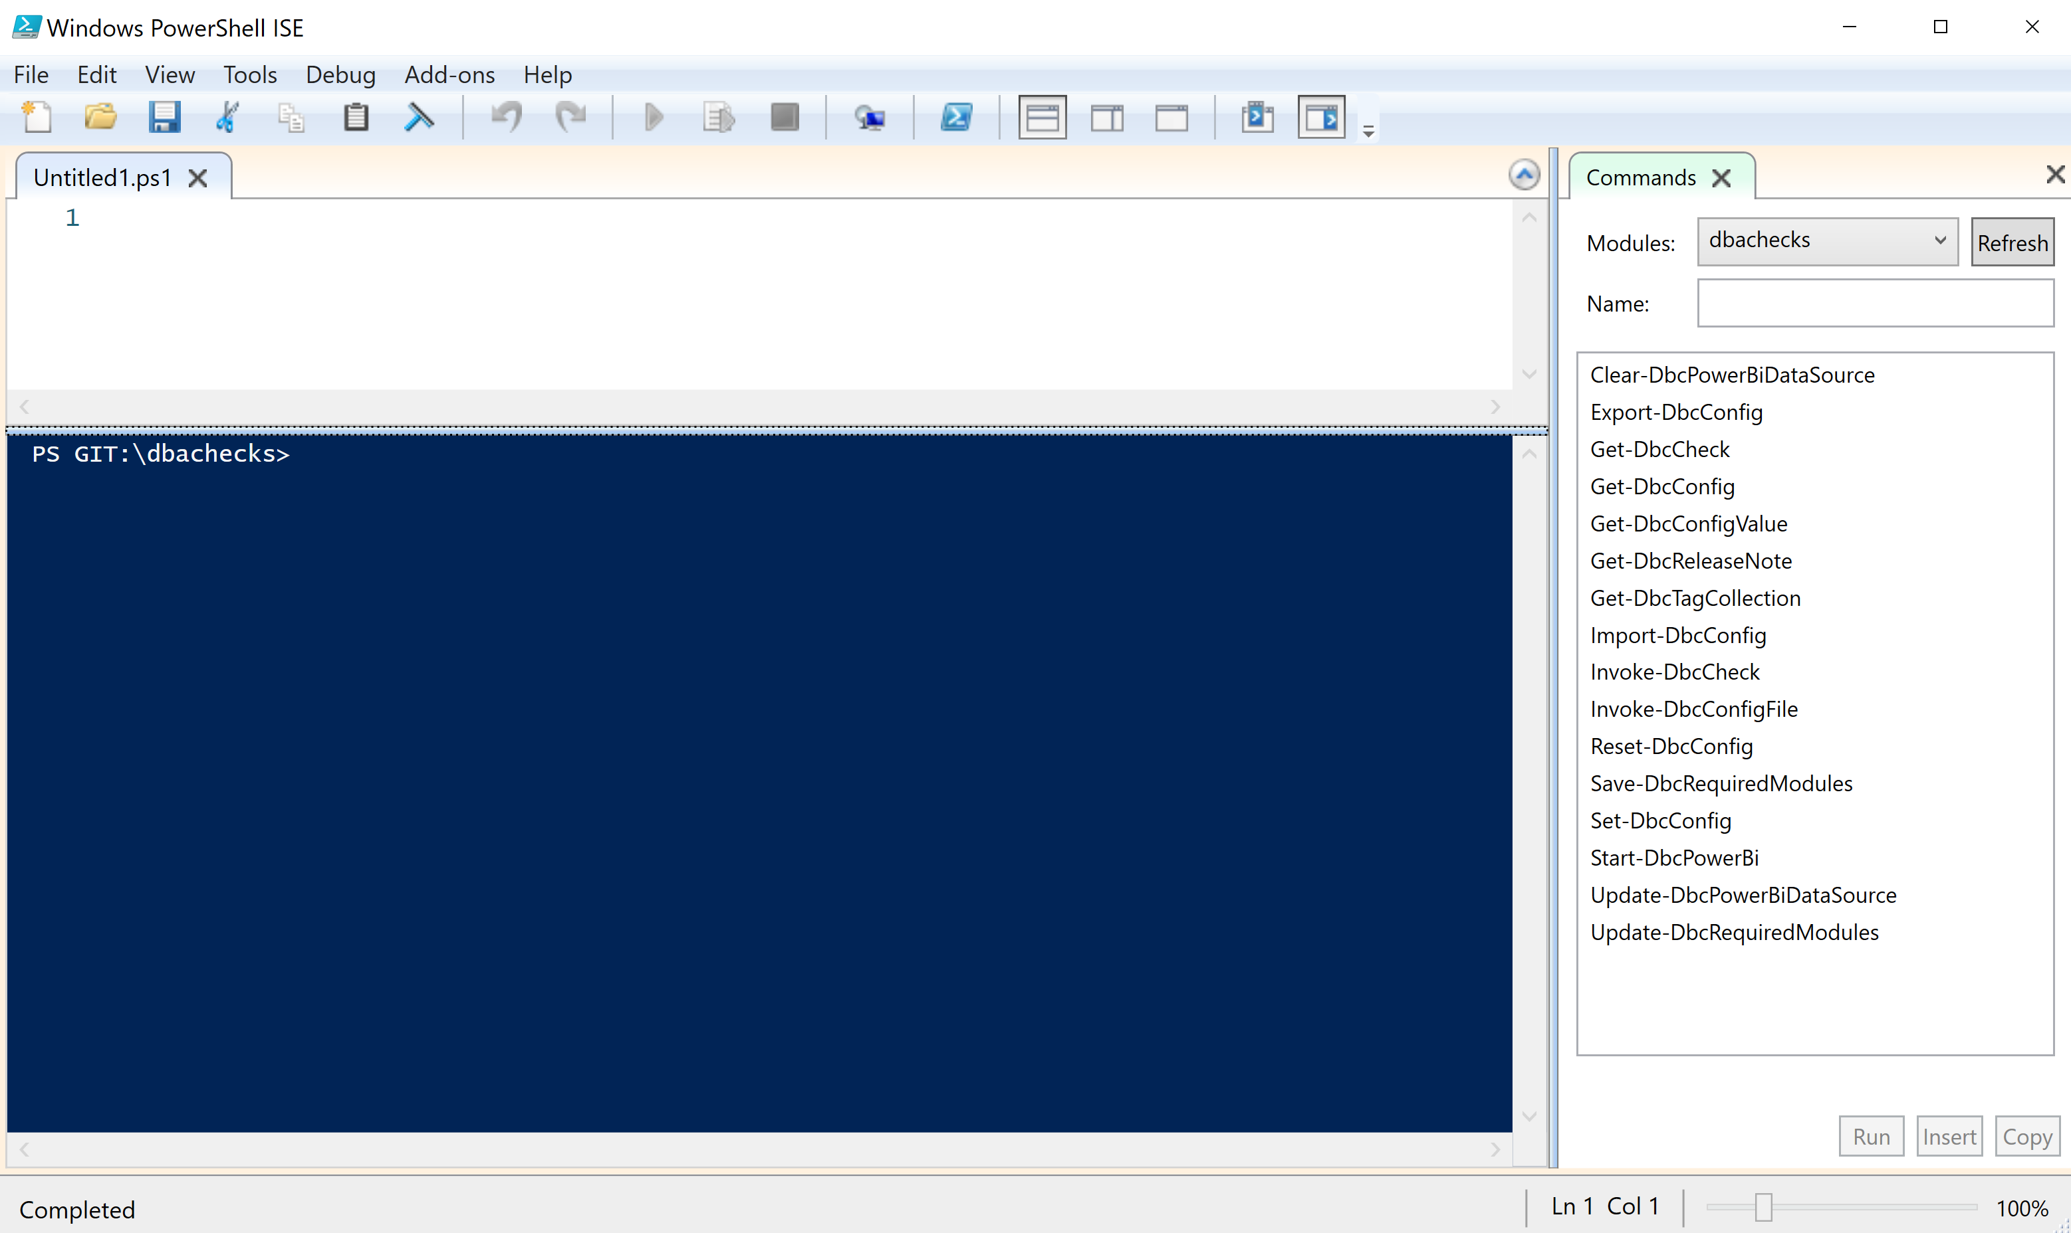
Running PowerShell
2017

Slide 12
Running PowerShell
2017

Slide 13
Running PowerShell
2017

Slide 14
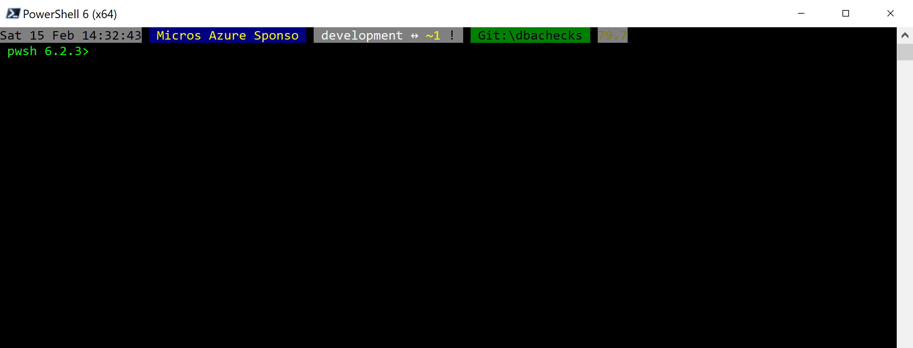
Running PowerShell
2018

Slide 15
Running PowerShell
2018

Slide 16
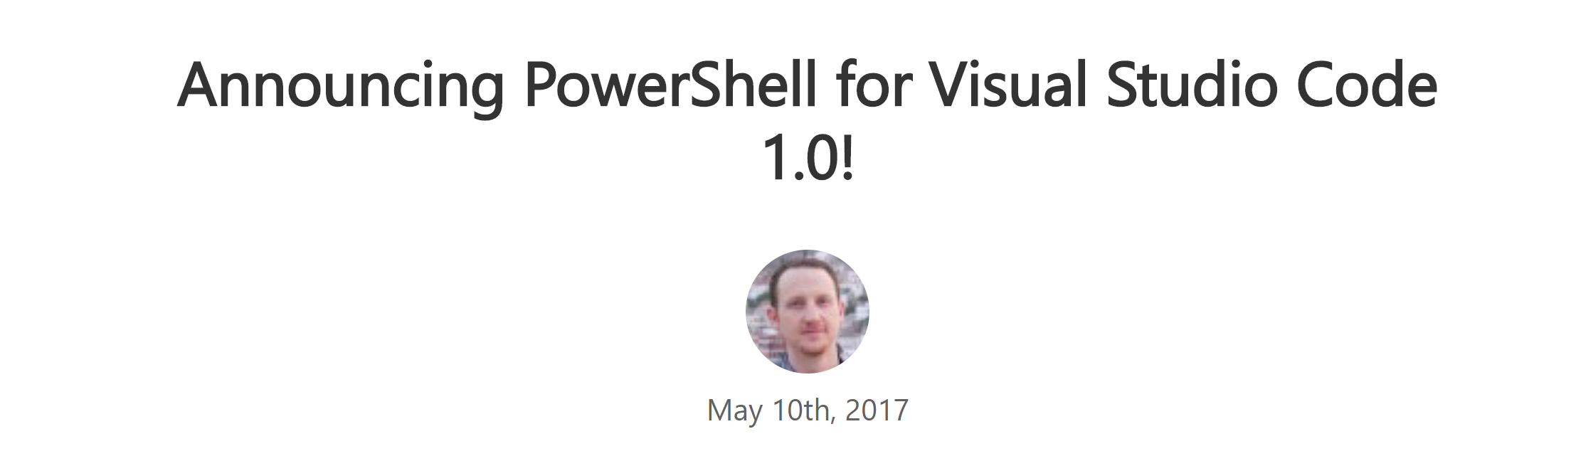
Running PowerShell
2016-17

Slide 17
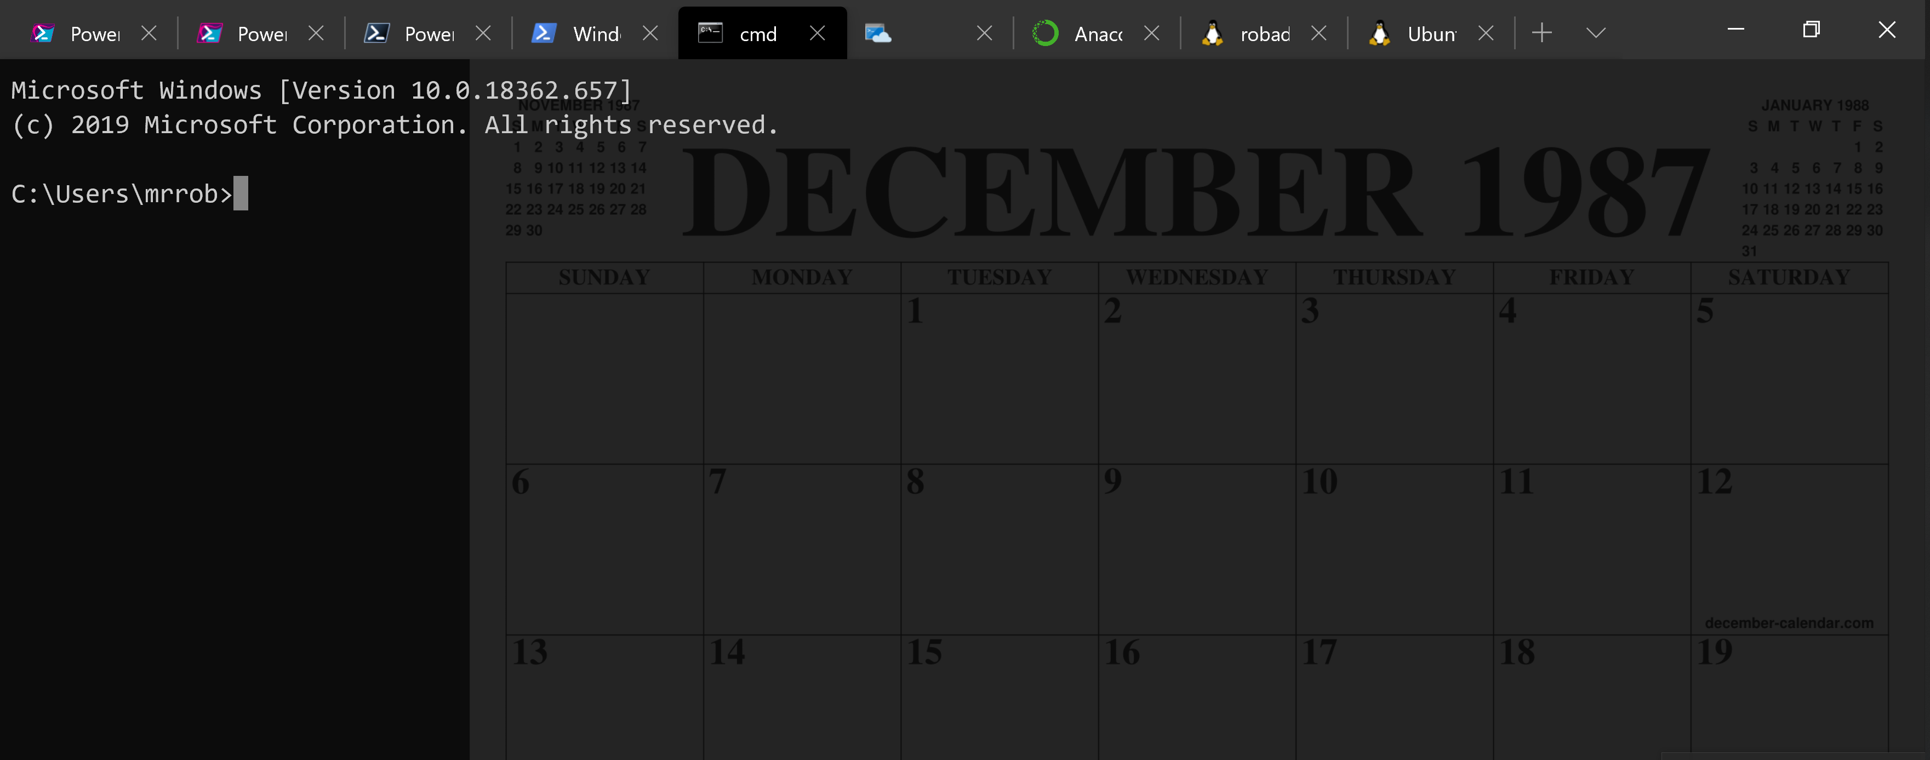
Running PowerShell
2016-17

Slide 18
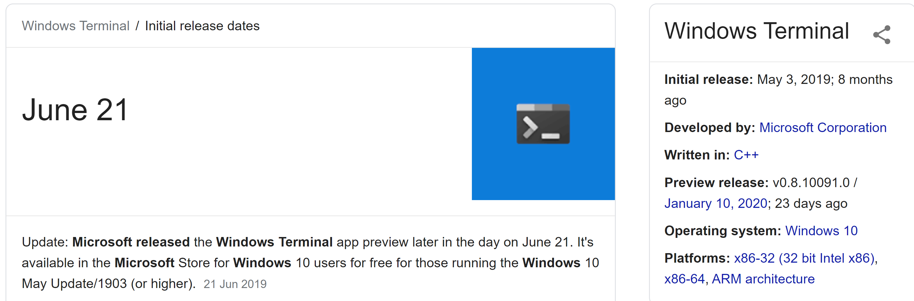
Running PowerShell
2019

Slide 19
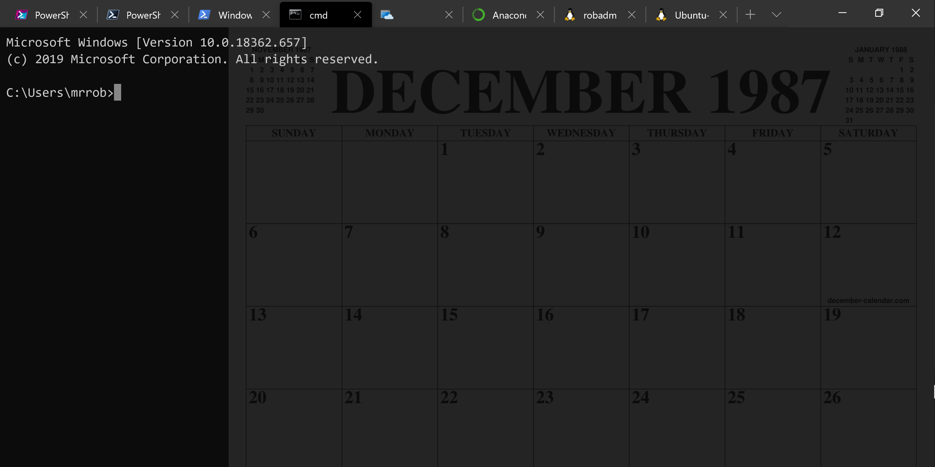
Running PowerShell
2019

Slide 20
Running PowerShell
2019

Slide 21
A Decade and a Half

Slide 22
Uh, Houston, we've had a problem
https://en.wikipedia.org/wiki/Houston,_we_have_a_problem

Slide 23
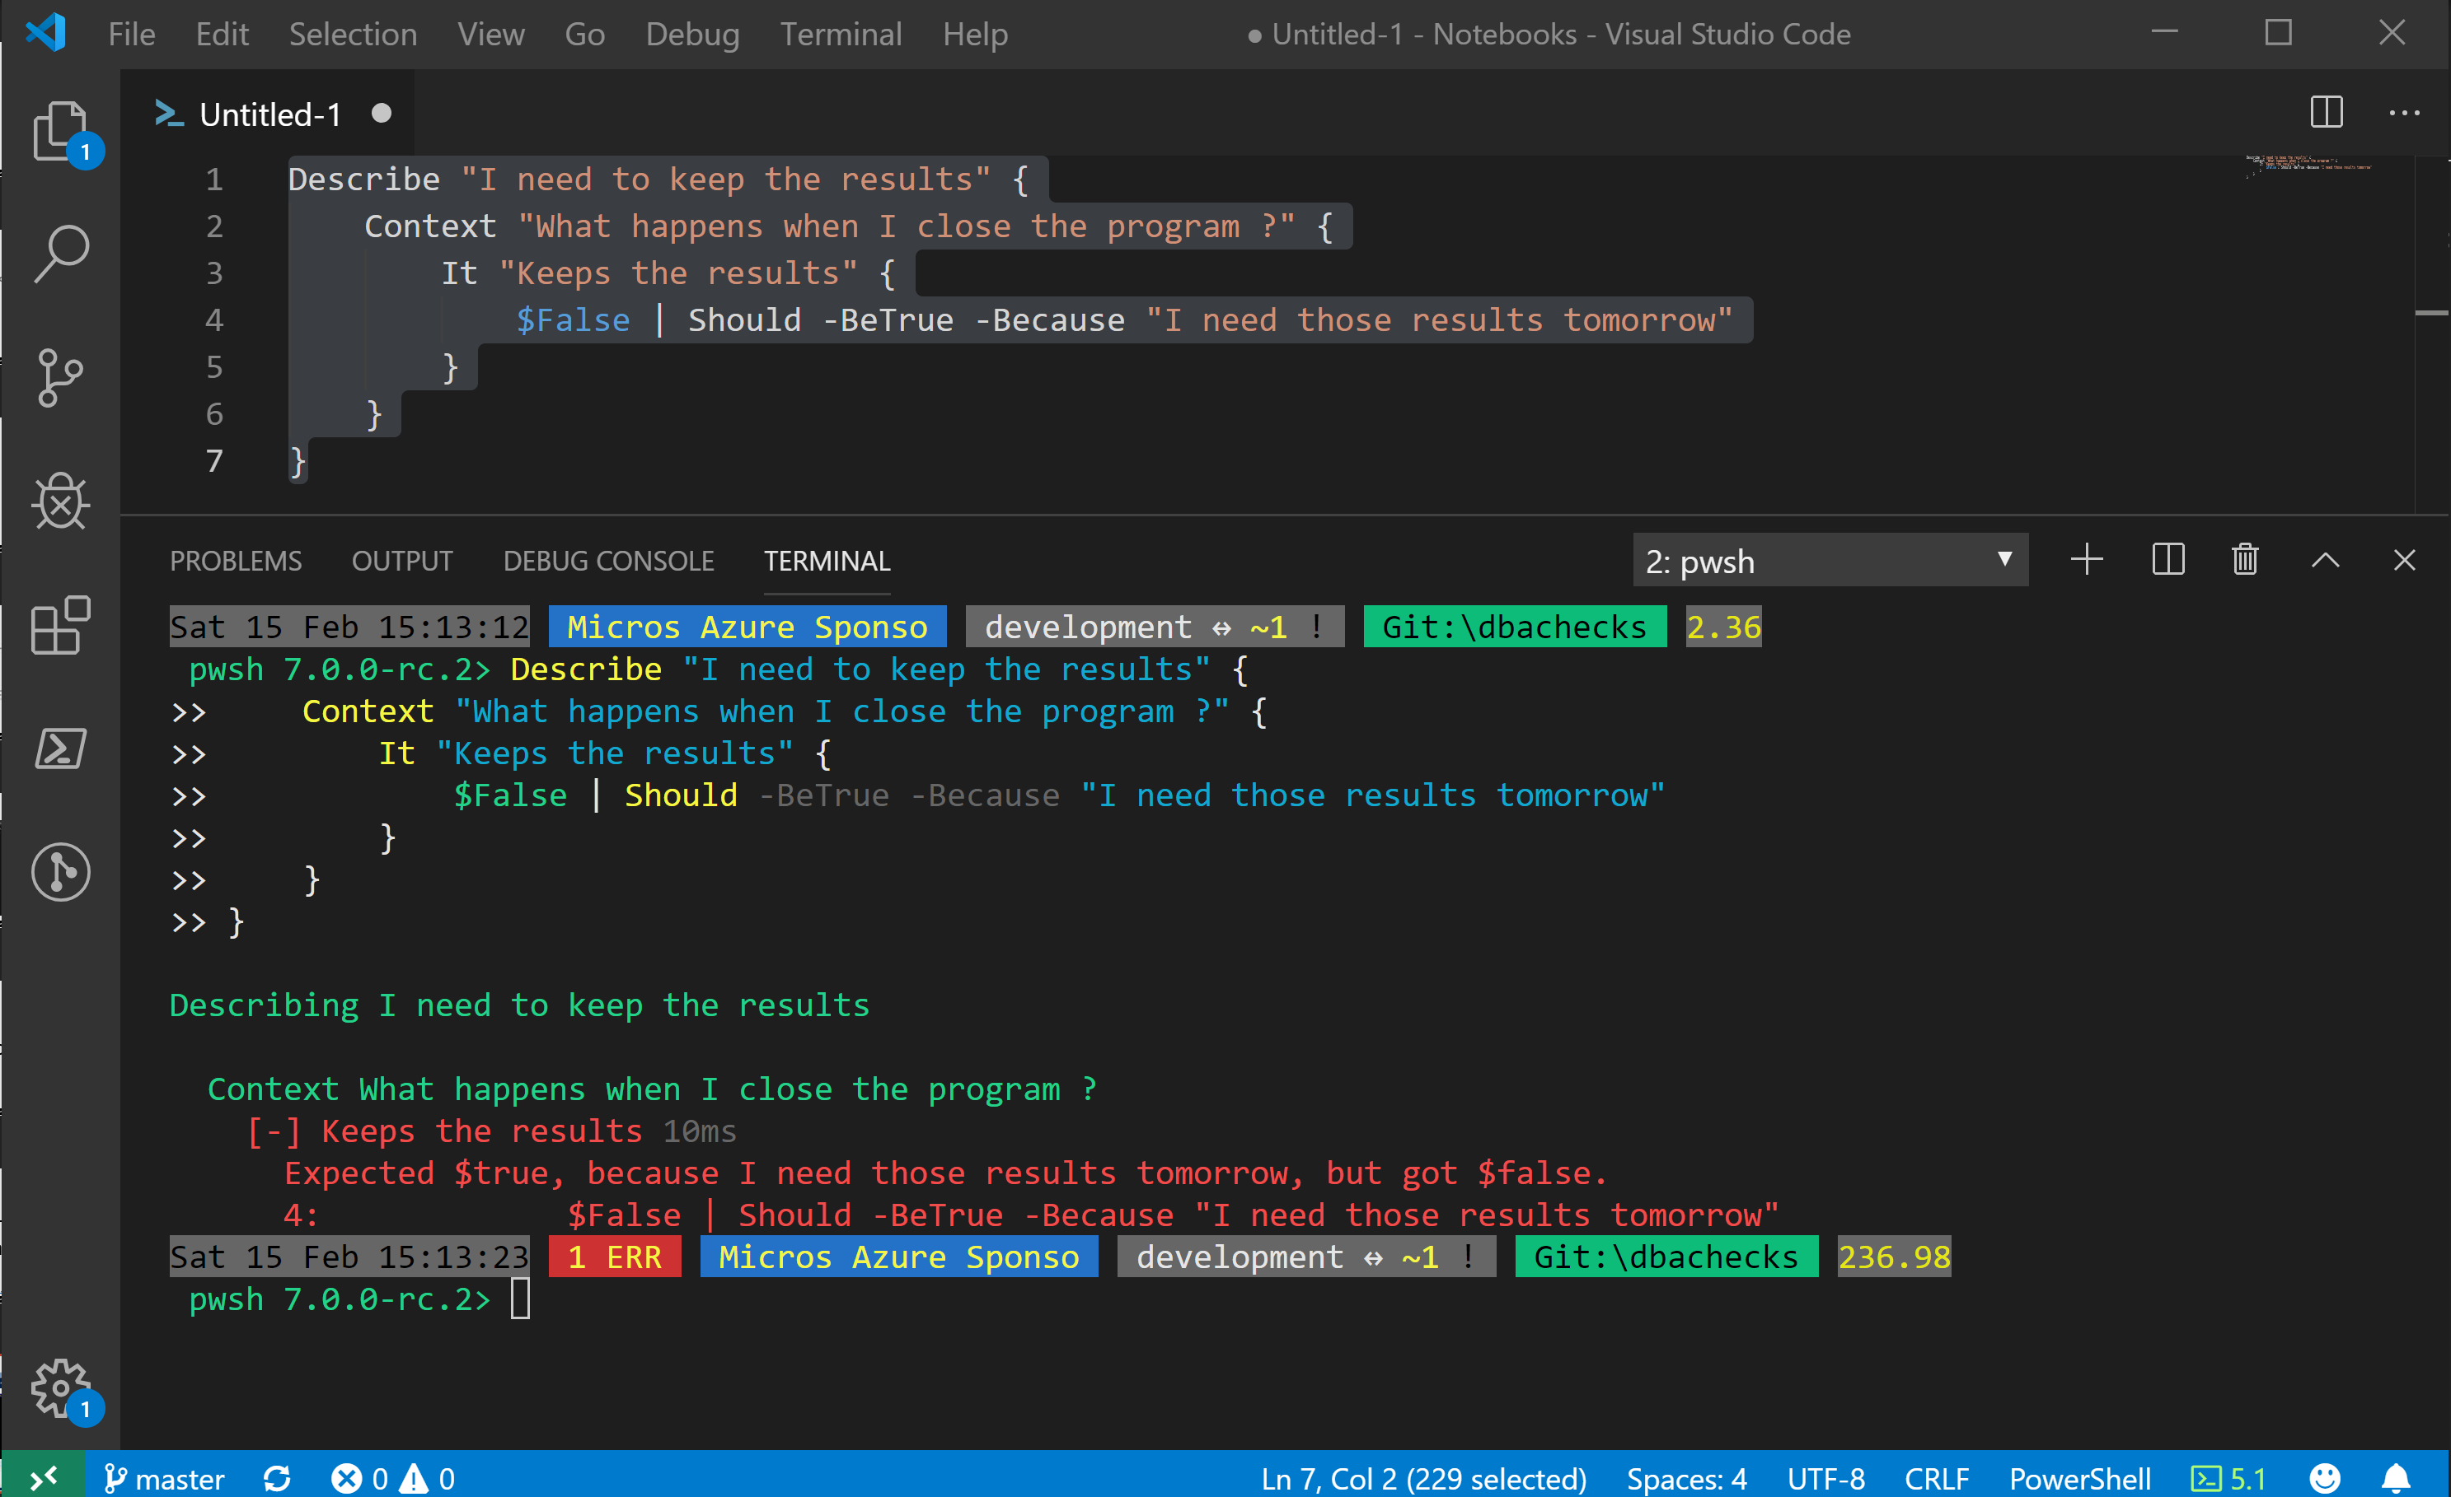
Without some effort………..

Slide 24
Without some effort………..

Slide 25
Without some effort………..

Slide 30
ALL
GONE

Slide 31


Slide 32
Jupyter

Slide 33

What is a Jupyter Notebook?
Originally for Data Scientists

Slide 34
What is a SQL Notebook?
Document that can contain text, code, images and query results

Slide 35
What is a SQL Notebook?
Document that can contain text, code, images and query results

Slide 36
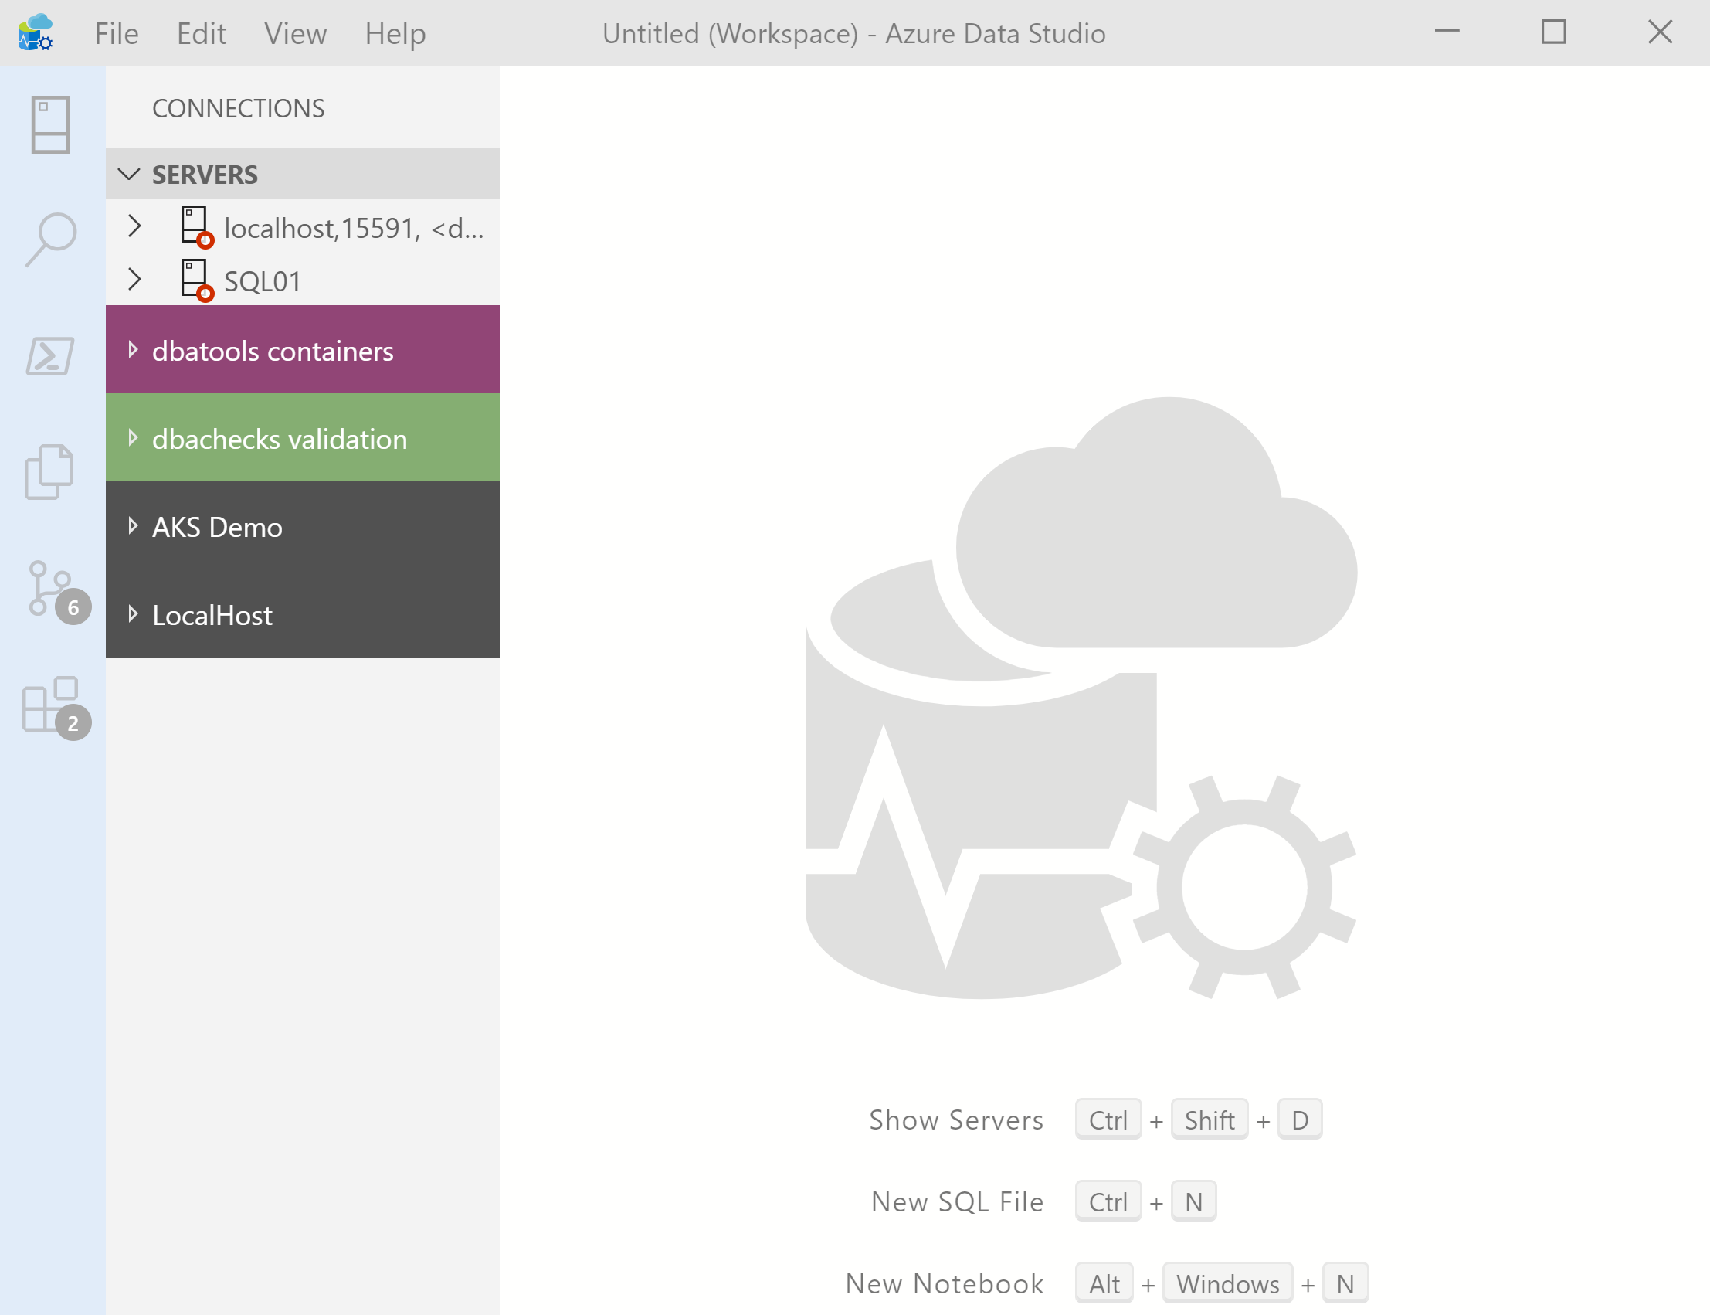

What’s Azure Data Studio ?
Cross Platform desktop environment for Data Professionals

Slide 37
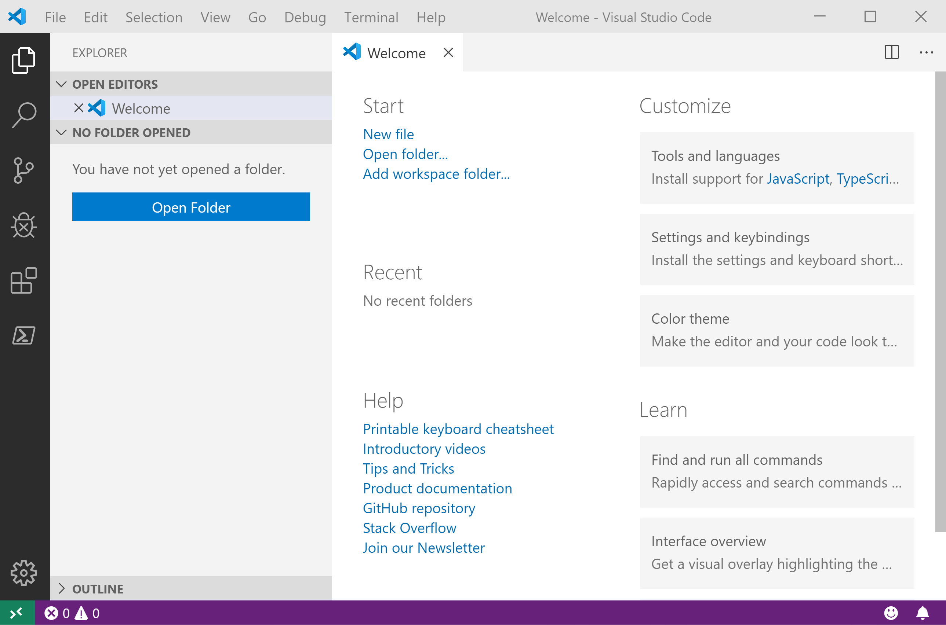
It Looks Like Visual Studio Code ?

Slide 38
It Looks Like Visual Studio Code ?

